Slide 1

HOME
DISCUSSION
CONCLUSION
INTRODUCTION TO
Round Robin
Presented by Group 2

Slide 2
Members: Von Jaycel Bas Regie Garcia Jhon Abito Ian James Lyndon Charls Lawagon
Trina Bantug Rhea Sabal Hannah Camille Cathrine Esconde
Rissa Sabal
HOME
DISCUSSION
CONCLUSION
Presented by Group 2

Slide 3

HOME
DISCUSSION
CONCLUSION
Introduction
Round Robin Scheduling is a CPU scheduling algorithm that assigns time slices (quantum) to processes.
- Each process gets equal CPU time in cyclic order.
- Ensures fairness and avoids starvation.
- Commonly used in time-sharing systems.

Slide 4

How it works
HOME
DISCUSSION
CONCLUSION
Each process gets equal time slice (Quantum)
If not finished, it goes to back of queue
Prevents CPU starvation
Fair scheduling method

Slide 5

Time Quantum
HOME
DISCUSSION
CONCLUSION
Time Quantum defines how long a process can execute before switching to the next process.
Smaller quantum = faster response but more switching overhead.

Slide 6
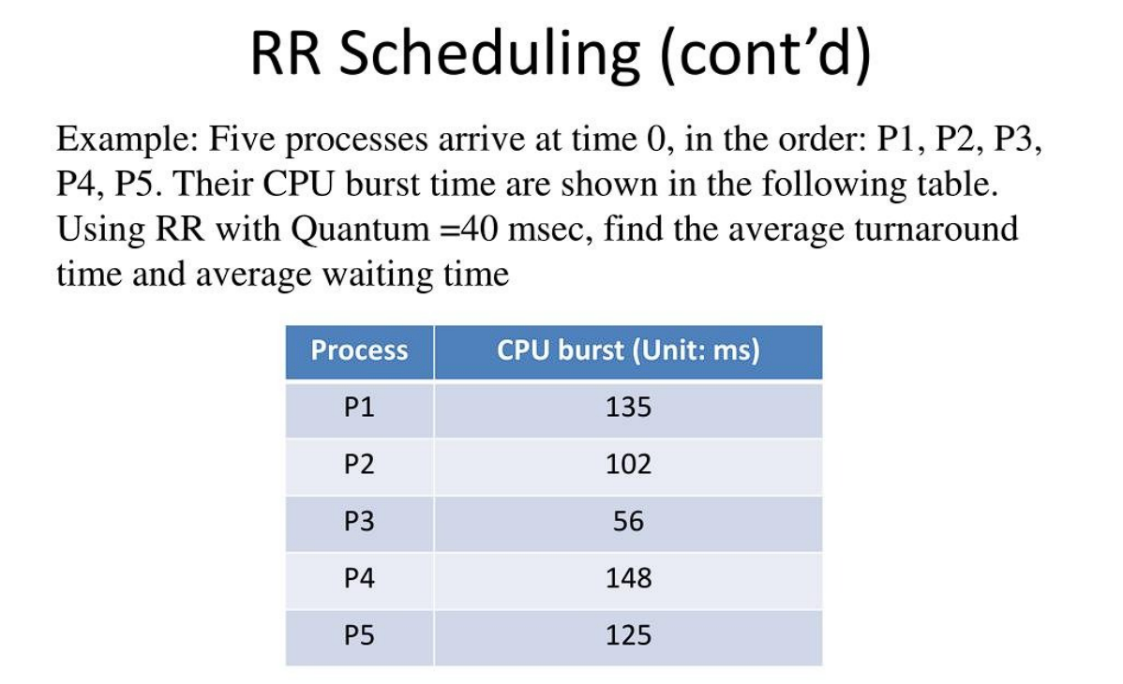
HOME
DISCUSSION
CONCLUSION

Slide 7
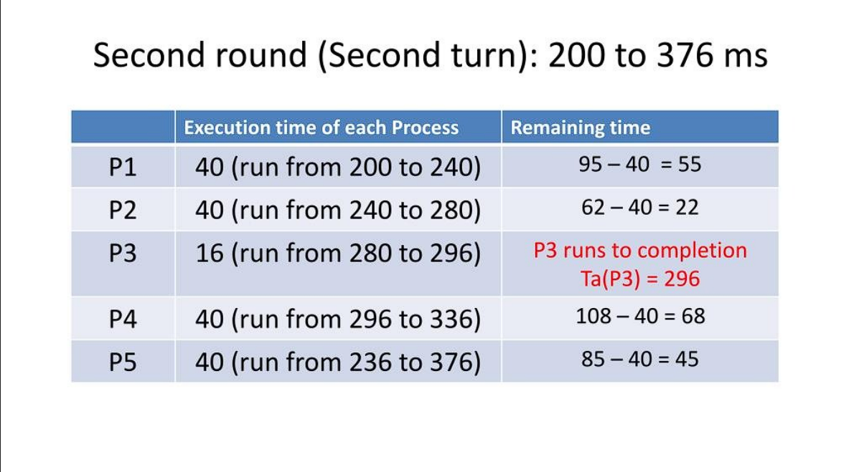
HOME
DISCUSSION
CONCLUSION

Slide 8
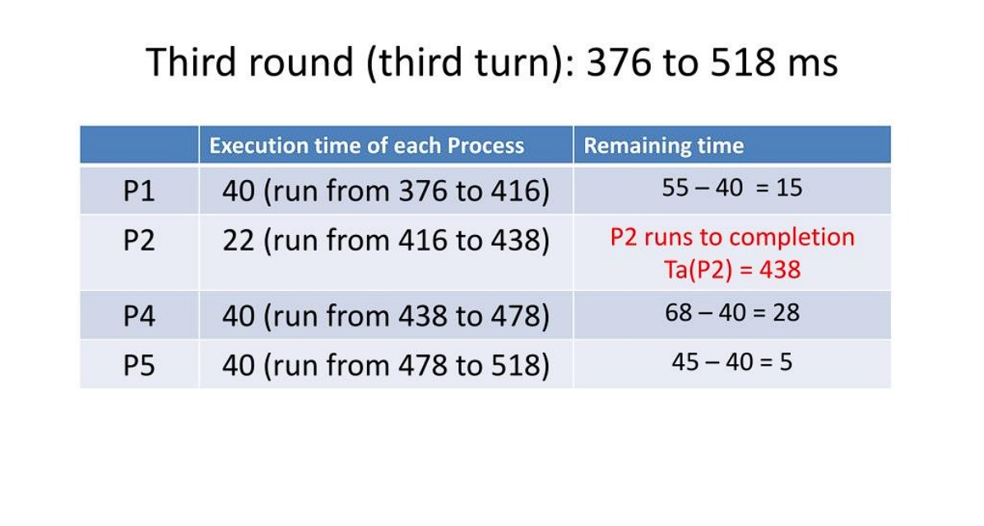
HOME
DISCUSSION
CONCLUSION

Slide 9
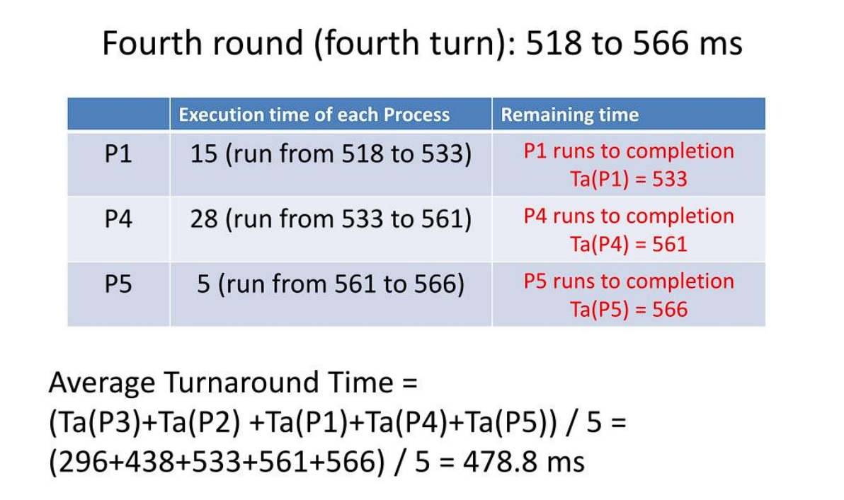
HOME
DISCUSSION
CONCLUSION

Slide 10
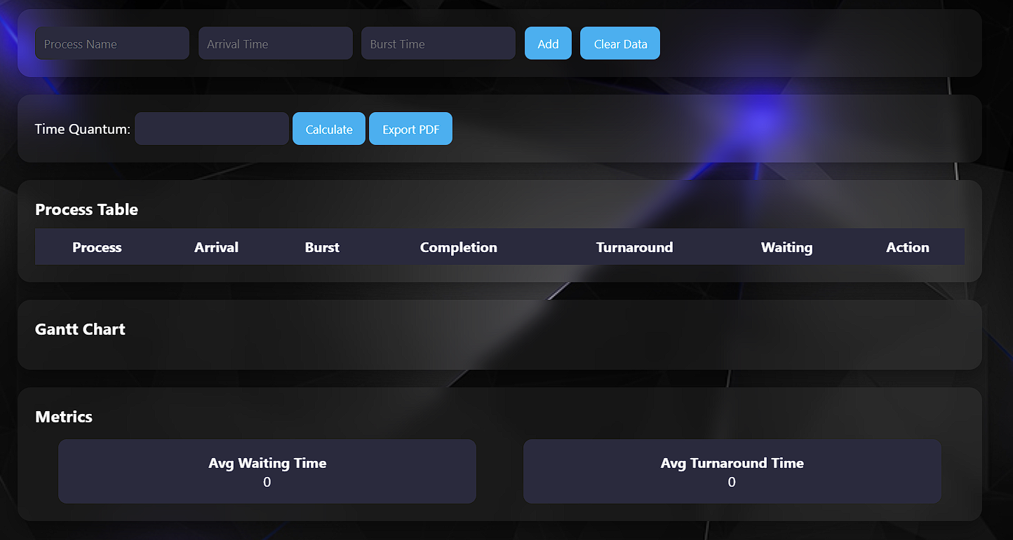
HOME
DISCUSSION
CONCLUSION
System Features
Add/Edit/Delete Processes
Editable Table
Dynamic Gantt Chart
Average Waiting Time
Average Turnaround Time
Export to PDF

Slide 11
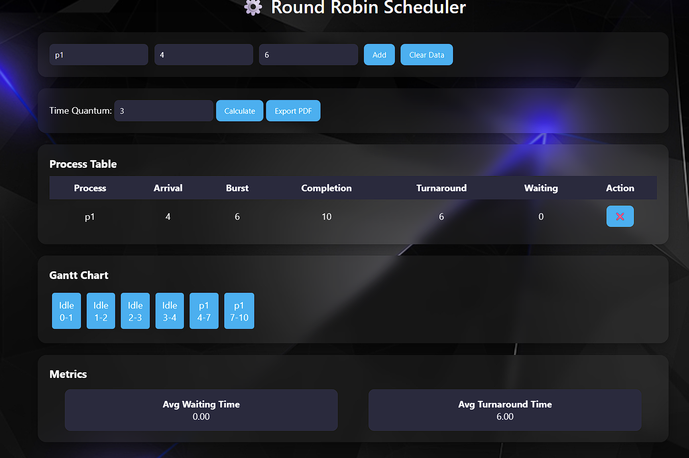
System Interface
HOME
DISCUSSION
CONCLUSION

Slide 12
Algorithm Logic
HOME
DISCUSSION
CONCLUSION
Processes stored in queue
Execution based on arrival time
Remaining burst tracked
Completion time computed dynamically

Slide 13
Gantt Chart
HOME
DISCUSSION
CONCLUSION
- Visual representation of CPU execution order.
- Shows which process runs at what time interval.

Slide 14
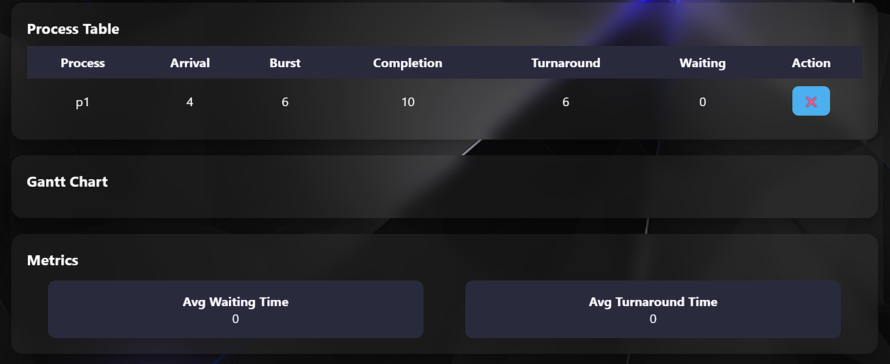
HOME
DISCUSSION
CONCLUSION
Performance Metrics
Waiting Time = Turnaround - Burst
Turnaround Time = Completion - Arrival
• Average values show system efficiency

Slide 15


HOME
DISCUSSION
CONCLUSION
Conclusion
Round Robin Scheduling is an efficient and fair CPU scheduling algorithm. It improves system responsiveness and avoids starvation. The simulator helps users learn and analyze scheduling effectively.

Slide 16
HOME
DISCUSSION
CONCLUSION
Thank You
Presented by Group 2

